Slide 1

OM SRI SAI RAM
MDSC-201-REGRESSION METHODS
BR Sricharan -23902

Slide 2
CHAPTER 3 – MULTIPLE LINEAR REGRESSION
3.2.1 Least - Squares Estimation of the Regression Coefficients

Slide 3

3.2.1 Least - Squares Estimation of the Regression Coefficients
It is called a multiple linear regression model with k regressors.
The parameters βj , j = 0, 1, . . . , k , are called the regression coefficients .
This model describes a hyperplane in the k - dimensional space of the regressor variables xj

Slide 4
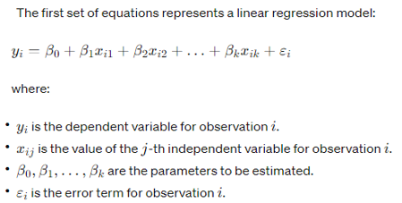

Slide 5
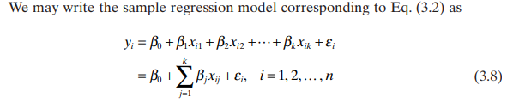

Slide 6

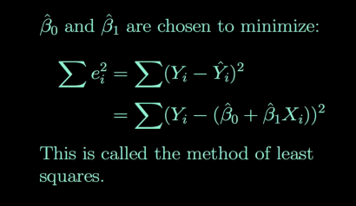
Review (Sum of Squared Errors)SSE in SLR

Slide 7
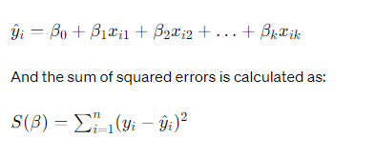

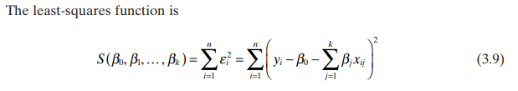
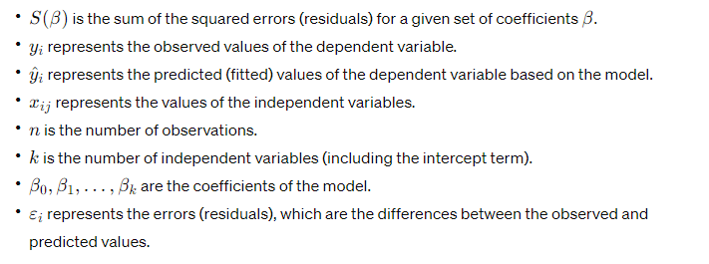

Slide 8

Conditions for least squares estimators β^​0​,β^​1​,…,β^​k​.
These estimators are obtained by minimizing the sum of squared errors S with respect to the coefficients β0​,β1​,…,βk​.
To find the least squares estimators, we need to take partial derivatives of the sum of squared errors S with respect to each coefficient βj​ (where j=0,1,…,k), set them equal to zero, and solve for the coefficients.

Slide 9


LEAST - SQUARES NORMAL EQUATIONS

Slide 10

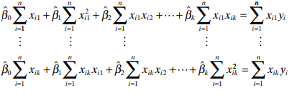
LEAST - SQUARES NORMAL EQUATIONS
There are p = k + 1 normal equations, one for each of the unknown regression coefficients. The solution to the normal equations will be the least - squares estimators β^​0​,β^​1​,…,β^​k​.

Slide 11
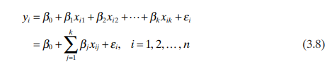

It is more convenient to deal with multiple regression models if they are expressed in matrix notation. This allows a very compact display of the model, data, and results. In matrix notation, the model given by Eq. (3.8)

Slide 12
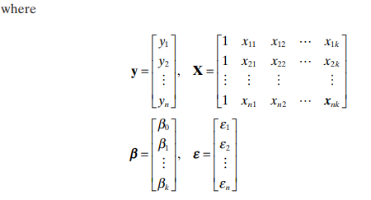
It is more convenient to deal with multiple regression models if they are expressed in matrix notation. This allows a very compact display of the model, data, and results. In matrix notation, the model given by Eq. (3.8)
y is an n × 1 vector of the observations.
X is an n × p matrix of the levels of the regressor variables.
β is a p × 1 vector of the regression coefficients.
ε is an n × 1 vector of random errors.

Slide 13
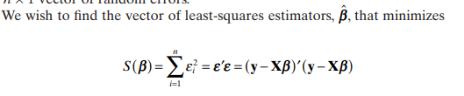


Slide 14
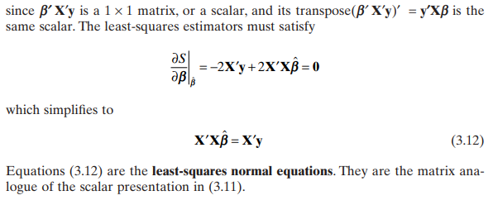

Slide 15
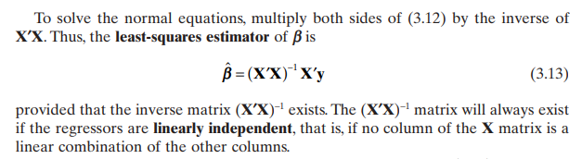

Slide 16
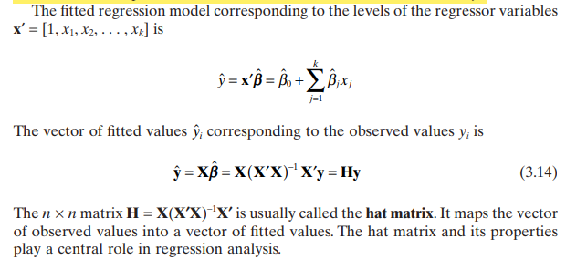

Slide 17
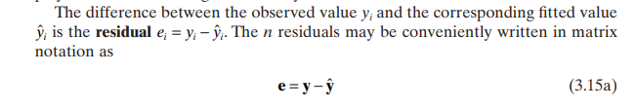


Slide 18
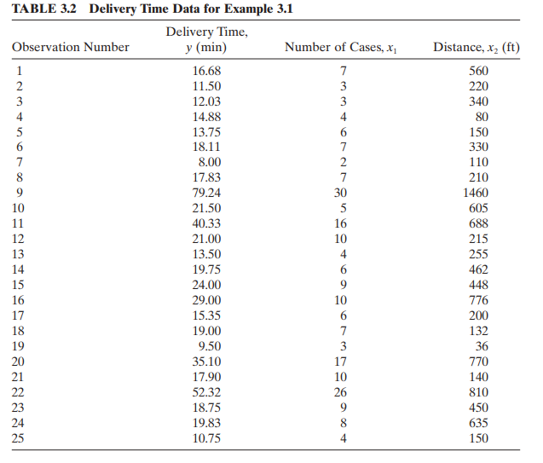
LETS SOLVE AN EXAMPLE

Slide 19
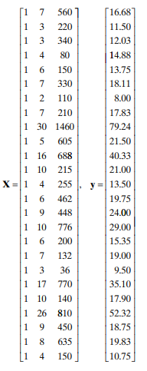

Slide 21
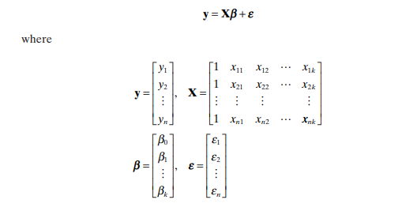

Slide 22

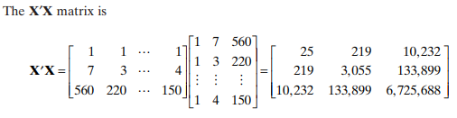

Slide 23
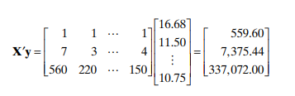
The X’y vector is

Slide 24
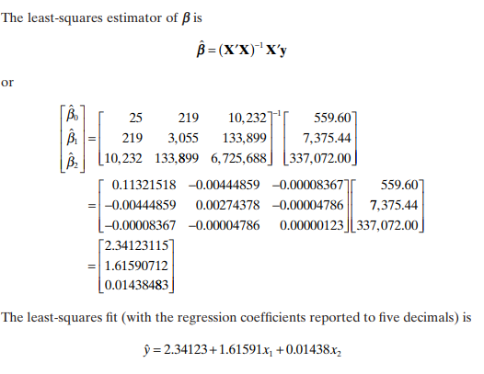

Slide 25
END OF 3.2.1 Least - Squares Estimation of the Regression Coefficients

Slide 26
THANK YOU SAIRAM

